Slide 1
STA/BST 222 Survival Analysis Lecture 15
Lihong Qi
Division of Biostatistics
Department of Public Health Sciences
School of Medicine
Nov 19, 2020

Slide 2
How to contact me
Email is best: lhqi@ucdavis.edu
Phone: 530-754-9234
Office hour: email for an appointment

Slide 3
How to contact TA
Xiner Zhou
Email: xezhou@ucdavis.edu
Office hours: 7:00pm – 8:00pm, Thursdays
Lab: 6:10-7:00 pm, Thursdays
For both Lab and OH, please use the zoom link with passcode: survival https://ucdstats.zoom.us/j/9681353237?pwd=ZzhLRHlhNG92bHFUaHkwM0Fib1pqQT09 Meeting ID: 968 135 3237

Slide 4
Focus
Semiparametric proportional hazards (PH) regression
Estimation of the survival function
Model diagnostics

Slide 5
Breslow’s estimator
Estimate the survival probability for a subject with a given set of covariates Z.
The estimator of the survival function is based on Breslow’s estimator of the baseline cumulative hazard rate.
Note: reduces to the NA estimator when

Slide 6
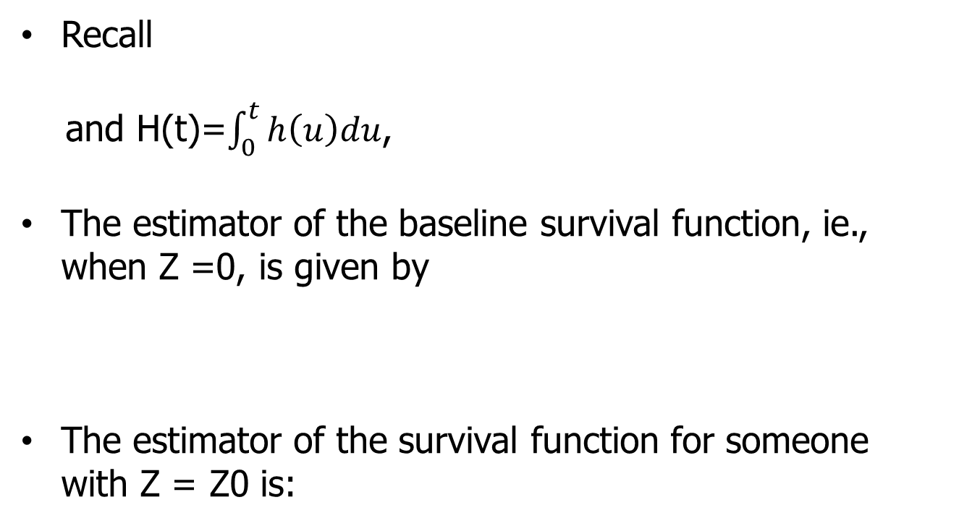
Estimating survival function
Recall
and H(t)=$\int_{0}^{t}{h\left(u\right)du}$,
The estimator of the baseline survival function, ie., when Z =0, is given by
The estimator of the survival function for someone with Z = Z0 is:

Slide 7
Regression Diagnostics

Slide 8
Residuals for Survival Data
Cox-Snell residuals
Martingale residuals
Deviance residuals
Score residuals

Slide 9
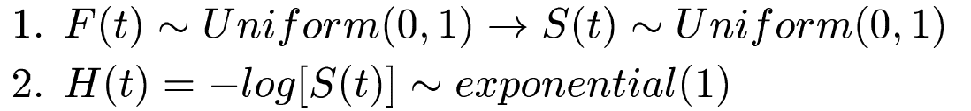
Cox-Snell Residuals
Facts:

Slide 10
Cox-Snell Residuals (cont’d)
Residual plot vs
can be used for checking overall fit of the Cox PH
model.
If the model fits the data, the plot should follow the 45 degree line.
Draw back: cannot tell you what’s wrong with the model!
Note:

Slide 11
Example: Bone Marrow Transplantation study, KM 1.3
h(t|Z1-Z8)=h0(t)exp[b1*Z1+…+b8*Z8]
Z8: MTX use
Fit not too bad!
Disease free survival

Slide 12
Example: Bone Marrow Transplantation study, KM 1.3
PH not met.
No MTX Use
MTX Use

Slide 13
Determine the functional form of a covariate

Slide 14
Martingale residuals
Note:

Slide 15
Example: BMT for HL or NHL, KM 1.10
This suggests that waiting time from diagnosis to transplant can be coded in the Cox model as an indicator variable.
z1: disease; z2: type of transplant; z3: z1*z2; z4:karnofsky score
h(t|z1,z2,z3)=h0(t)exp[b1*z1+b2*z2+b3*z3+b4*z4]
waiting time to transplant

Slide 16
Example: BMT for HL or NHL, KM 1.10

Slide 18
Other Residuals

Slide 19
Proportional hazards assumptions

Slide 20
Not parallel
Auto has better survival at earlier time;
Allo has better later on

Slide 21
Curve is not constant over time

Slide 22
The plot appears to be roughly concave, suggesting that the ratio h(t | allo) / h(t | auto) is a function decreasing with time.

Slide 23
AIC and R^2
The AIC is reminiscent of the adjusted R^2 in least-squares regression since both are attempting to adjust the fit of the model by the number of parameters included.
Allison discusses a "generalized" R² statistic that is based on the likelihood-ratio statistic for testing the global null hypothesis. It does not have a "proportion of variation explained by the model" interpretation.
Allison states, "R-square does not tell you anything about how appropriate the model is for the data" and "It's just a statistic between 0 and 1 that is larger when the covariates are more strongly associated with the dependent variable.“
Allison, Paul D. 1995. Survival Analysis Using the SAS System: A Practical Guide. Cary, NC: SAS Institute Inc.

Slide 24
Homework 4
Reading: KM 8.6, 11.1-11.4
Others: to be posted

Slide 25
Notes
Presentation: choose one project for a 5 minutes presentation + 2 minutes Q&A.
12/8, 12/10
Final reports of both projects will be due on 12/12/2020.
Final summary report (10%): review and summarize useful things you have learned in this course and how you have applied them and/or plan to apply them in your future research or career. Due by 12/12/2020

